Slide 1
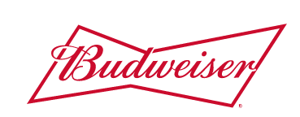

Budweiser Data Analysis
Paul Huggins & Vijayasrikanth Kaniti

Slide 2
Project scope
Detect and analyze the relationships between data supplied by Budweiser containing details regarding different beers and breweries in the US.
The following 8 questions were of interest:
1. How many breweries are present in each state?
2. Address the missing values in each column.
3. Compute the median alcohol content and international bitterness unit for each state. Plot a bar chart to compare.
4. Which state has the maximum alcoholic (ABV) beer? Which state has the most bitter (IBU) beer?
5. Comment on the summary statistics and distribution of the ABV variable.
Is there an apparent relationship between the bitterness of the beer and its alcoholic content? Draw a scatter plot.
Investigate the different with respect to IBU and ABV between IPA’s and Ale.
ABV & Bottle Size

Slide 3
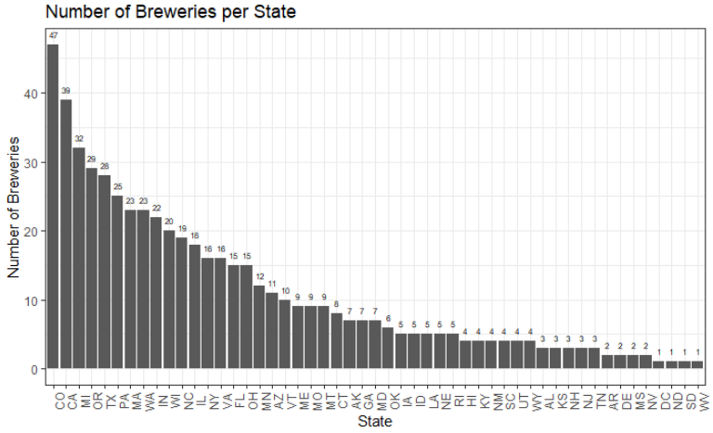
How many breweries are present in each state?
Top 5 States | Number of Breweries
Colorado | 47
California | 39
Michigan | 32
Oregon | 29
Texas | 28

Slide 4
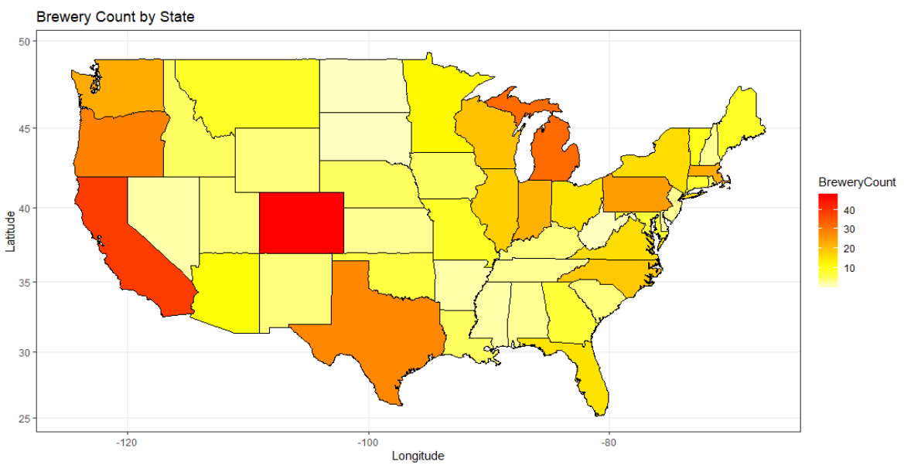
How many breweries are present in each state?

Slide 5
Addressing the missing values
62 missing values in the ABV column (2.5%).
1005 missing values in the IBU column (41.6%).
To address this, we looked at three options:
Removing the rows with missing data.
Setting all the missing values to be the median value of the entire column.
Using a linear regression model to impute what the data values might be by keying off of rows with complete data and assessing the relationship between the values. Imputation was done using the Mice package in R Studio and the method we used was predictive mean matching.
After implementing the Mice package, we obtained better estimated values for ABV and IBU which defined a more clear relationship between the two variables.

Slide 6
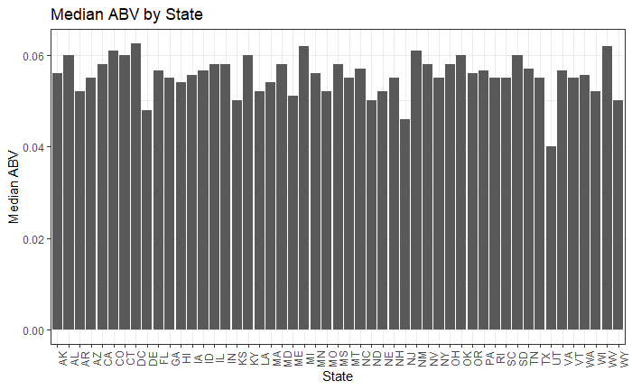
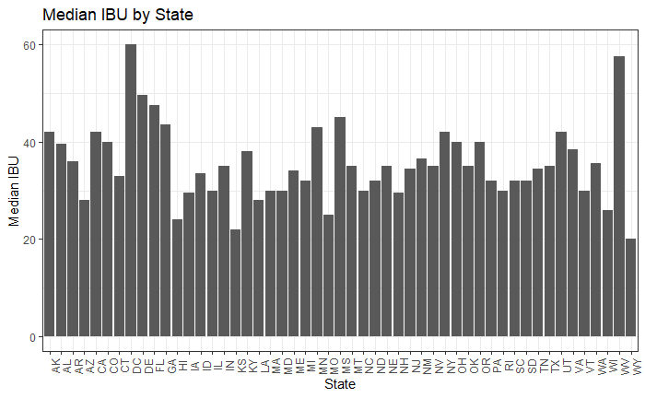
median alcohol content and international bitterness unit.
The median ABV by state was relatively constant with the overall median being 0.056 or 5.6%.
The median IBU by state contained more variance with the overall median being 35 Units.

Slide 7
HIGHEST alcoholic (ABV) beer & BITTER BEERS BY STATE?
State | Maximum ABV | Brewery | Beer
Colorado | 0.128 | Upslope Brewing Company | Lee Hill Series Vol. 5 – Belgian Style Quadruple Ale
Kentucky | 0.125 | Against the Grain Brewery | London Balling
Indiana | 0.120 | Tin Man Brewing Company | Csar
State | Maximum IBU | Brewery | Beer
Oregon | 138 | Astoria Brewing Company | Bitter Bitch Imperial Ale
Virginia | 135 | Wolf Hills Brewing Company | Troopers Alley IPA
Maine | 130 | Cape Ann Brewing Company | Dead-Eye DIPA

Slide 8
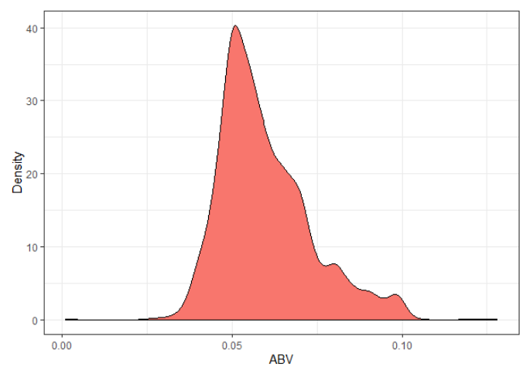
summary statistics and distribution of the ABV variable.
The average ABV of all the Beers in the dataset was 0.059 (5.9%).
It is safe to assume that the majority of beers have an ABV greater than 0.059 which could tell us something about the palette of the American Consumer.
Summary Statistics:
Max: 0.128
3rd Quarter: 0.067
Mean : 0.059
Median: 0.056
1st Quarter: 0.050
Minimum: 0.001

Slide 9
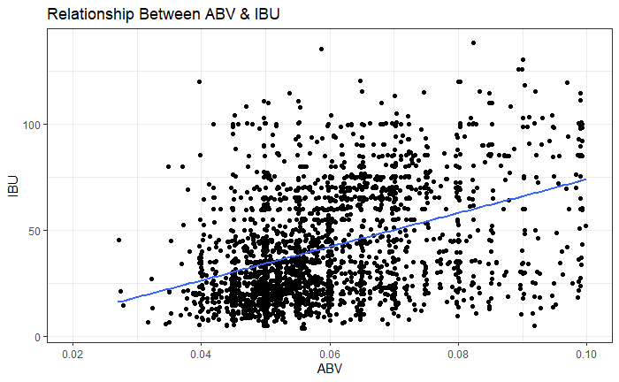
relationship between bitterness AND ALCOHOLIC CONTENT
There appears to be a positive relation between IBU & ABV.
There are a couple of factors that could contribute to this:
Americans may prefer a more balanced beer instead of a beer that favors ABV over IBU or vice versa.
To offset the taste of the bitterness, more hops are added which would result in a positive relationship.

Slide 10
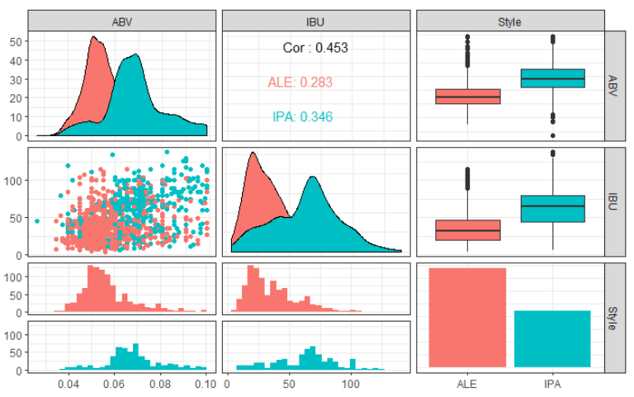
RELATIONSHIP BETWEEN IPA AND ALE BY using IBU AND ABV
We used a kNN model to predict the style of beer (Ale or IPA) based on what the ABV and IBU values were for that beer.
The model correctly predicted the type of beer ~79% of the time.
With 95% certainty, we believe that the model has an accuracy range between 75% to 83%.
If there were more numeric variables available (not including Ounces) we would expect the accuracy to increase given that the model would be using more predictors.

Slide 11
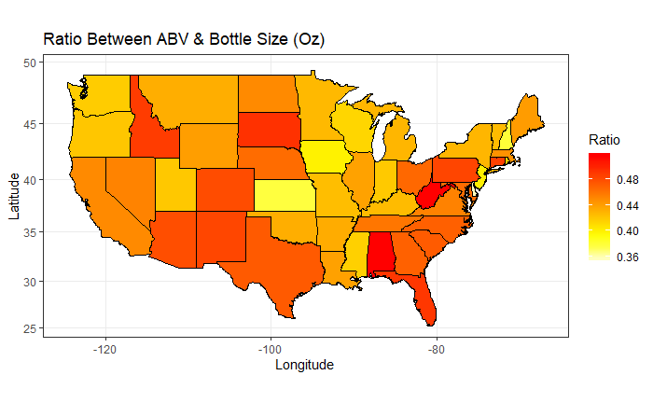
ABV & Bottle SIZE
Ratio between ABV & Bottle Size provides insight into types of beers are produced in each state.
This knowledge can be used to improve current marketing campaigns or breakthrough to new markets.
Kansas example:
Marketing a beer with a higher ABV than 0.05 and in a 12 Oz bottle would stand out among the other beers produced and could be the sole candidate to meet a demand.
Revamping existing beers in the 0.05 ABV & 16 Oz bottle might put pressure on the craft breweries given the brand recognition and loyal following that Budweiser has.
State | Average ABV | Average Bottle Size | Ratio*100
Texas | 0.055 | 12 | 0.458
Kansas | 0.050 | 16 | 0.312

Slide 12
Thank you

